Slide 1



FiRST CLOUD JOURNEY AI
GRAPHRAG
Build GraphRAG applications using Amazon Bedrock and Amazon Neptune
Presentation

Slide 2

FiRST CLOUD JOURNEY AI
WELCOME
Viet Phat
AI majoring at Swinburne University of Technology
Presentation

Slide 3

FiRST CLOUD JOURNEY AI
AGENDA
Introduction to RAG
Explore GraphRAG
Building the GraphRAG solution with Amazon Bedrock and Neptune
Conclusion
Presentation

Slide 4
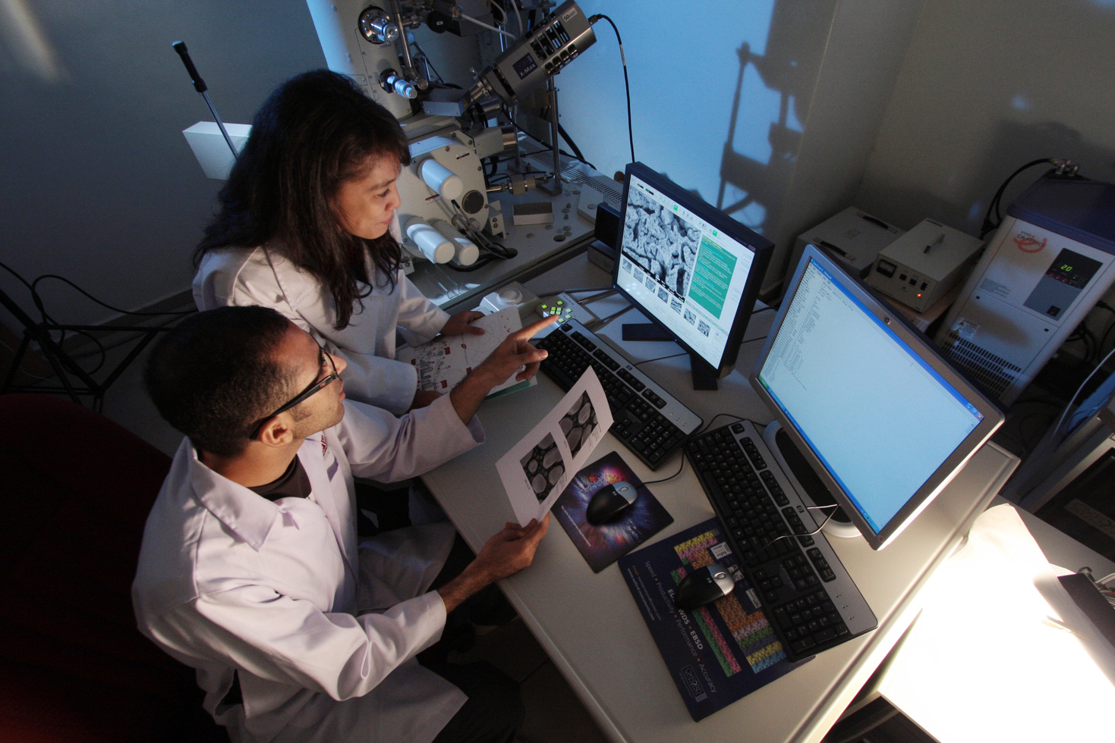


FiRST CLOUD JOURNEY AI
WHAT IS RAG
RAG augments an LLM with external knowledge at runtime by retrieving relevant passages from a knowledge base and injecting them into the prompt so the LLM generates answers grounded in that context.
Presentation
Read More

Slide 5
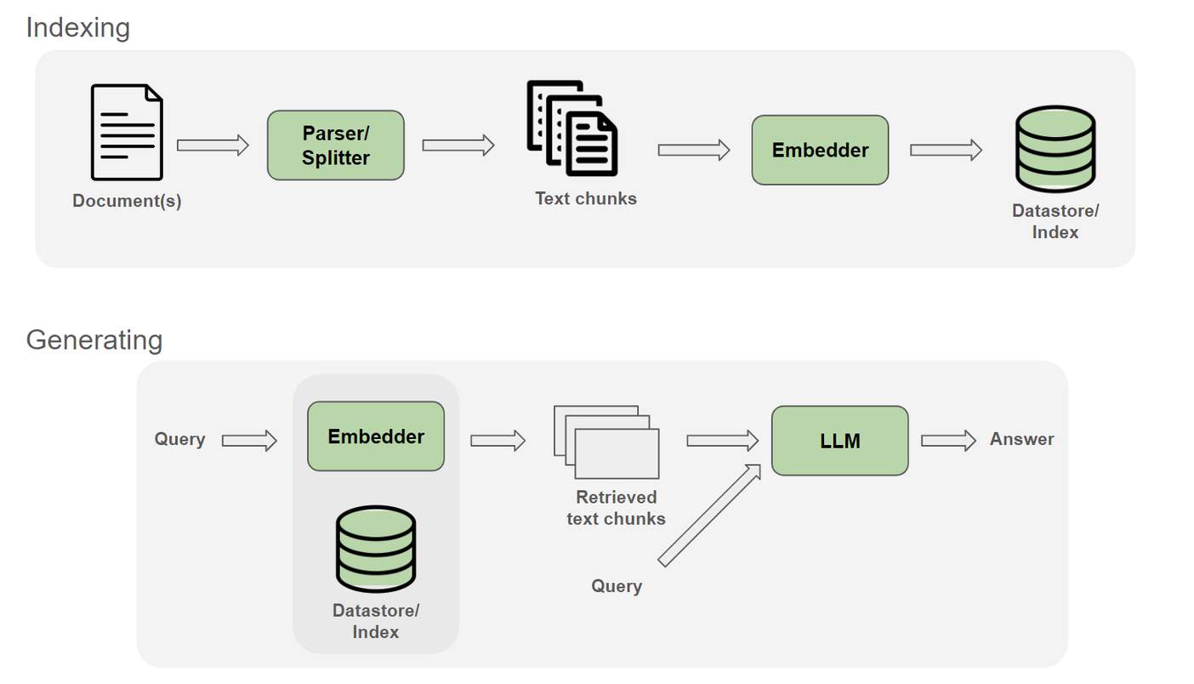
FiRST CLOUD JOURNEY AI
Ref: Nvidia
Presentation

Slide 6
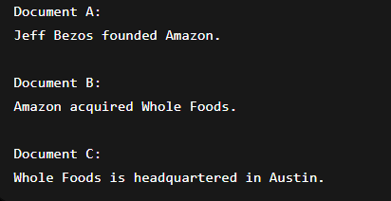
FiRST CLOUD JOURNEY AI
LIMITATION
Where is the company headquartered that was acquired by the company founded by Jeff Bezos ?
Presentation

Slide 7


FiRST CLOUD JOURNEY AI
1
Multi-hop Reasoning
Uses graph traversal to follow relationships across multiple entities and documents.
GRAPH
RAG
2
Relationship Awareness
Relationships are explicitly stored through the edges
Presentation

Slide 8
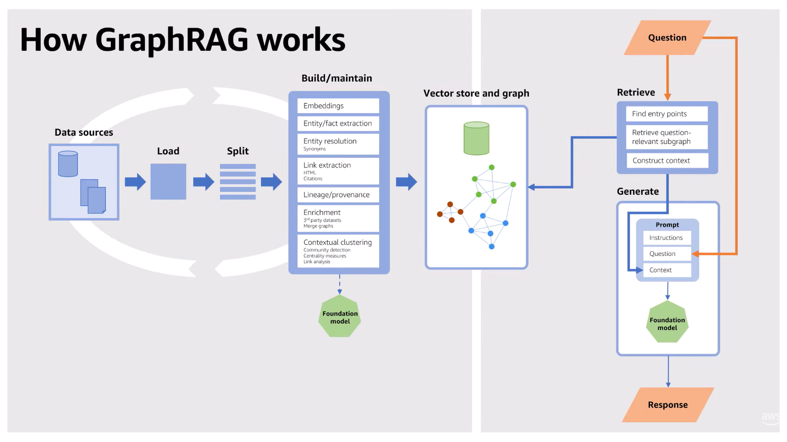
FiRST CLOUD JOURNEY AI
Presentation
Ref: Amazon Web Services

Slide 9
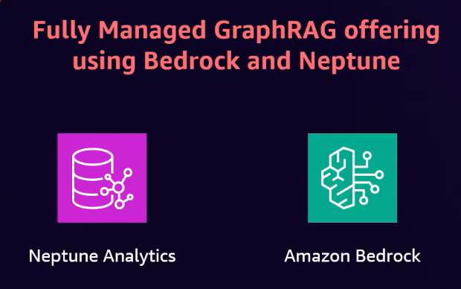
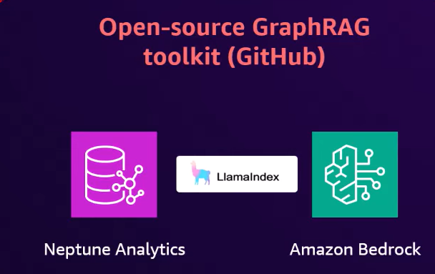
FiRST CLOUD JOURNEY AI
APPROACHES
Presentation

Slide 10

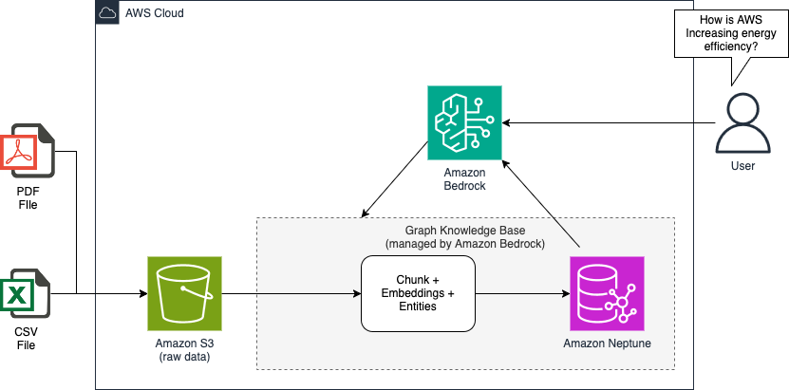
FiRST CLOUD JOURNEY AI
FULLY MANAGED ROUTE
Presentation
Ref: Amazon Web Services

Slide 11
FiRST CLOUD JOURNEY AI
FULLY MANAGED ROUTE
Amazon Bedrock Knowledge Bases: This is the managed GraphRAG engine that allows:
+ Chunk,
+ Entity extraction,
+ Embeddings generation
Amazon Neptune Analytics: This is the Graph brain of the system that focuses:
+ Graph storage
+ Constructed graph data (nodes, edges)
+ Relationship discovery
Presentation

Slide 12
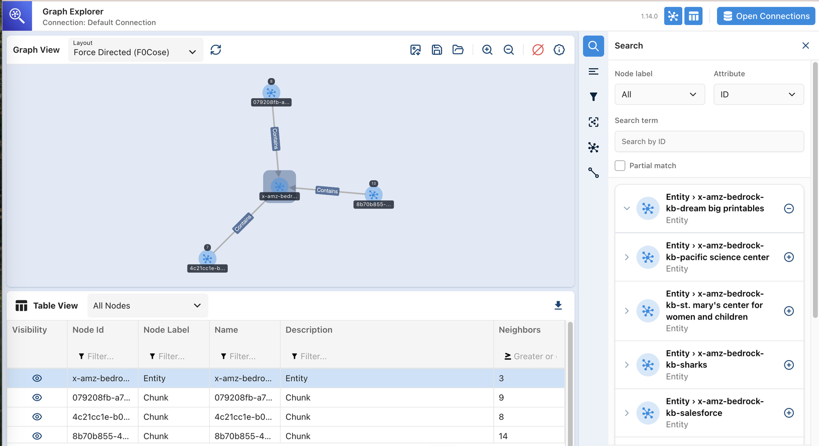
FiRST CLOUD JOURNEY AI
FULLY MANAGED ROUTE
Presentation
Ref: Amazon Web Services

Slide 13
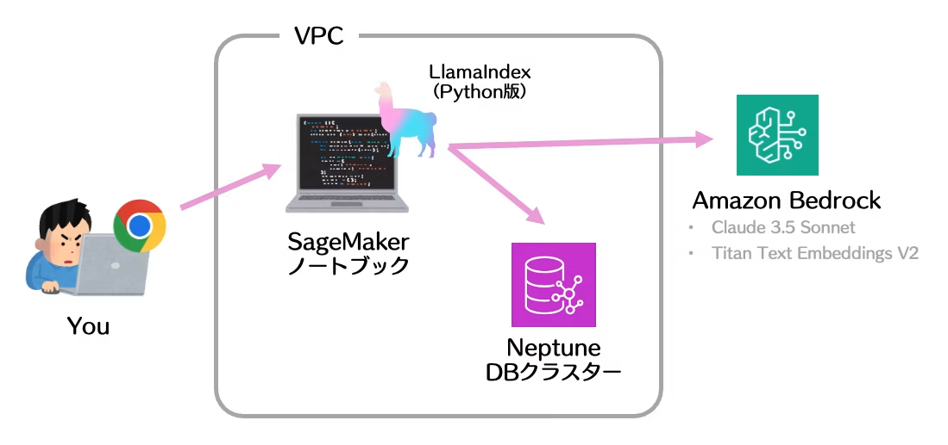

FiRST CLOUD JOURNEY AI
CUSTOM ROUTE
Presentation
Ref: Amazon Web Services

Slide 14
FiRST CLOUD JOURNEY AI
CUSTOM ROUTE
Custom Processing Pipeline: LLamaindex
+ Data preparation,
+ Knowledge graph construction,
Amazon Neptune:
+ Store the Knowledge Graph.
+ Multi-hop traversal
+ Cypher Query
Presentation

Slide 15
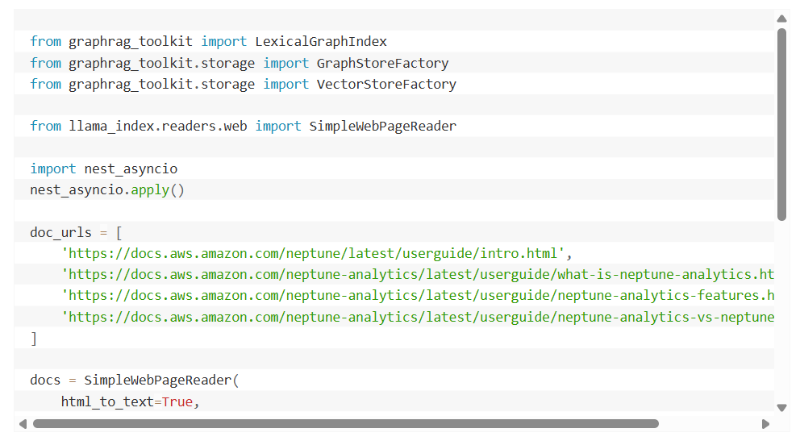
FiRST CLOUD JOURNEY AI
CUSTOM ROUTE
Presentation
Ref: Amazon Web Services

Slide 16
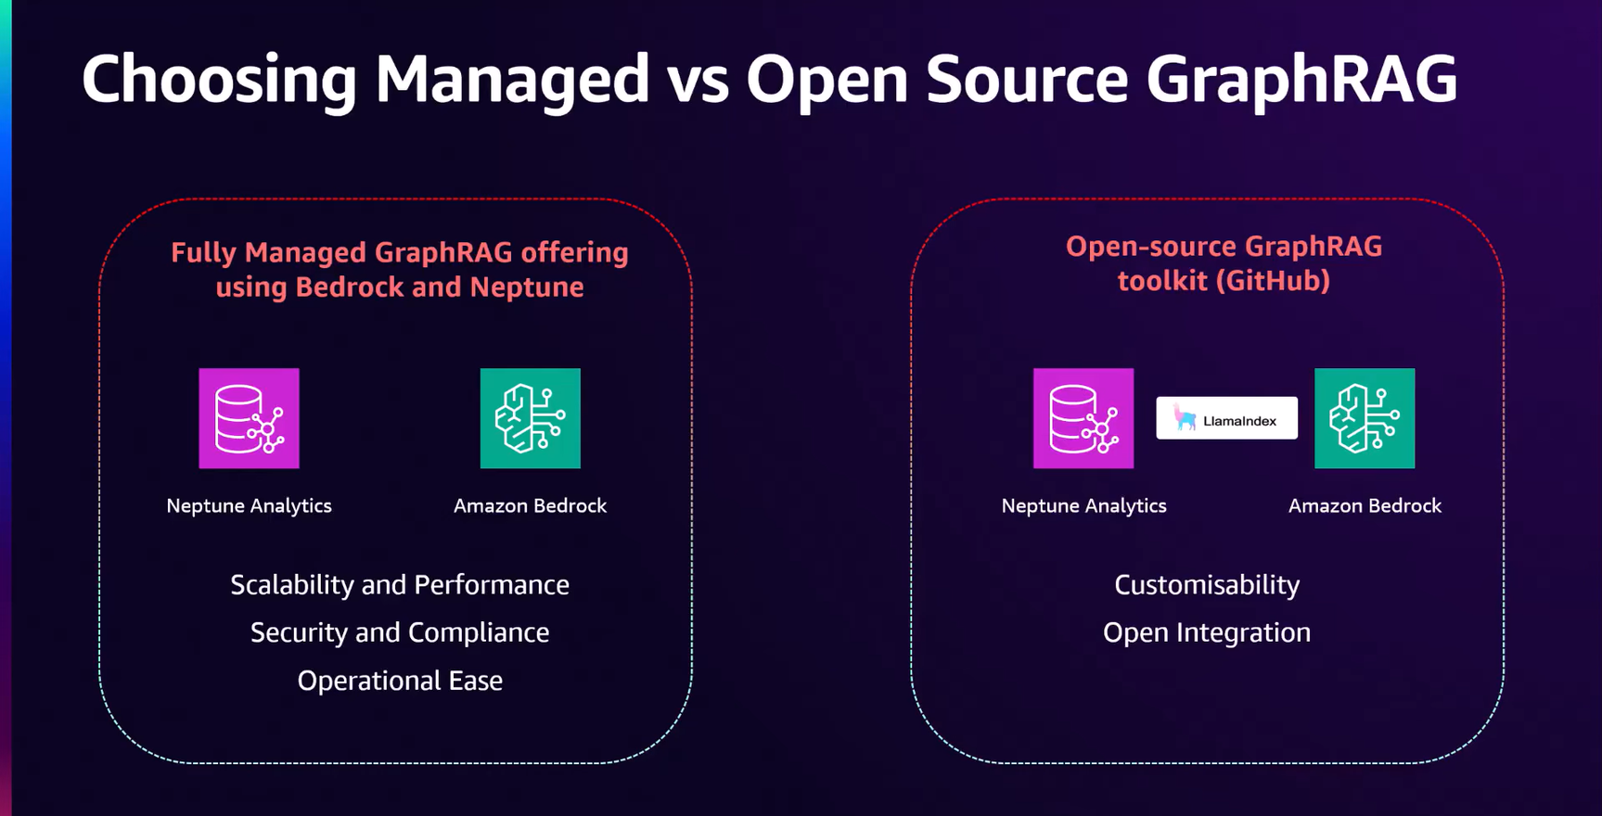
FiRST CLOUD JOURNEY AI
Ref: Amazon Web Service
Presentation

Slide 17

FiRST CLOUD JOURNEY AI
Q&A SECTION
Presentation

Slide 18

FiRST CLOUD JOURNEY AI
THANK YOU
Presentation

